Slide 1
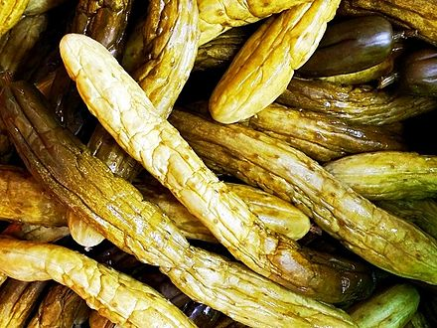

Data I/O - Pickle

Slide 2
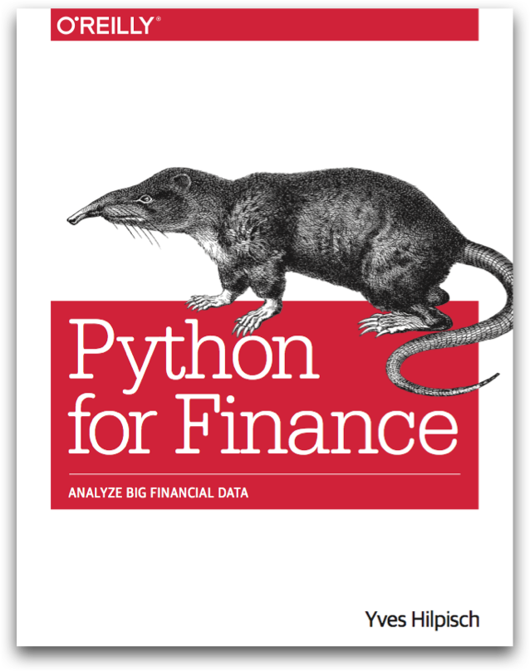
Reference
Chapter 7 of Python for Finance (O'Reilly)
Youtube
Code

Slide 3
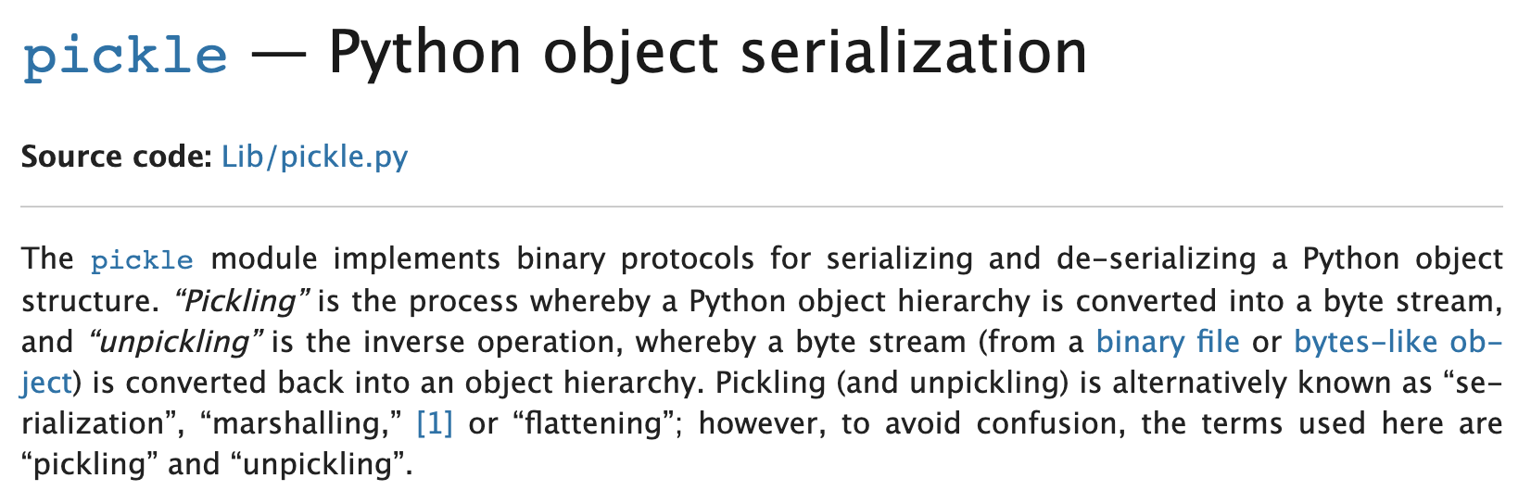
Pickle

Slide 4
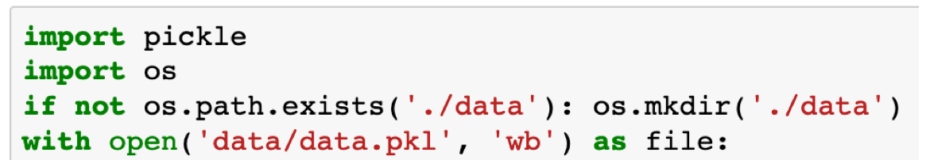
a
dump
load
Hard

Slide 5
a
dump
load
Hard
path
exists?

Slide 6
a
dump
load
Hard
path
exists?
make directory

Slide 7
a
dump
load
Hard
path
exists?
make directory
open

Slide 8
a
dump
load
Hard
path
exists?
make directory
open
file

Slide 9
a
dump
load
Hard
path
exists?
make directory
open
file
write mode

Slide 10
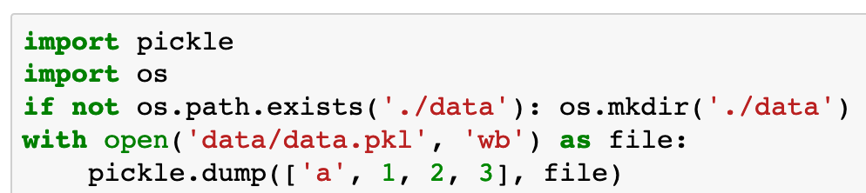
b
a
dump
load
Hard

Slide 11
b
a
dump
load
Hard
dump

Slide 12
b
a
dump
load
Hard
dump
data

Slide 13
b
a
dump
load
Hard
dump
data
to file

Slide 14
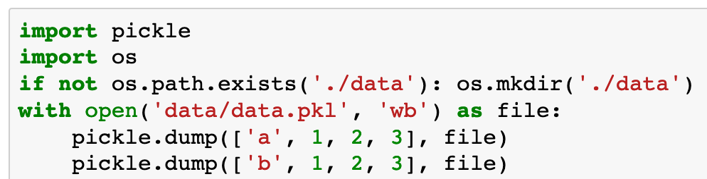
c
b
a
dump
load
Hard

Slide 15
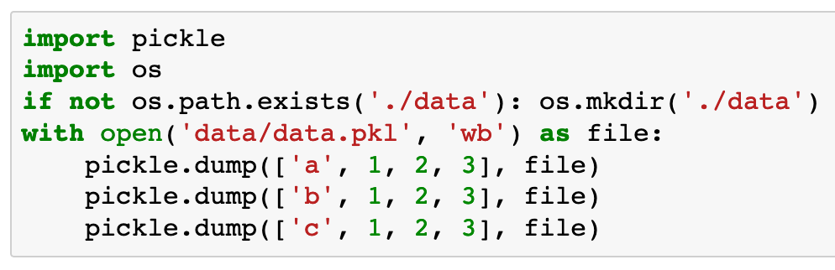
c
b
a
dump
load
Hard

Slide 16
c
b
a
dump
load
Hard

Slide 17
c
b
a
dump
load
Hard
open

Slide 18
c
b
a
dump
load
Hard
open
file

Slide 19
c
b
a
dump
load
Hard
open
file
read mode

Slide 20
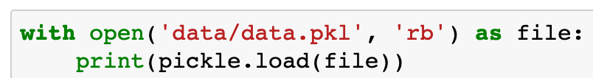
c
b
a
dump
load
Hard

Slide 21
c
b
a
dump
load
Hard
load

Slide 22
c
b
a
dump
load
Hard
load
file

Slide 23
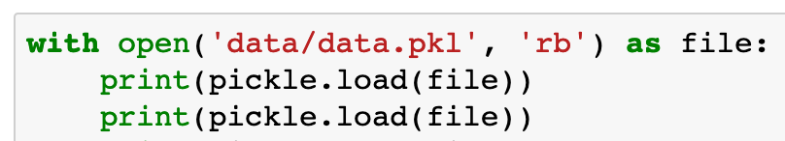
c
b
dump
load
Hard

Slide 24
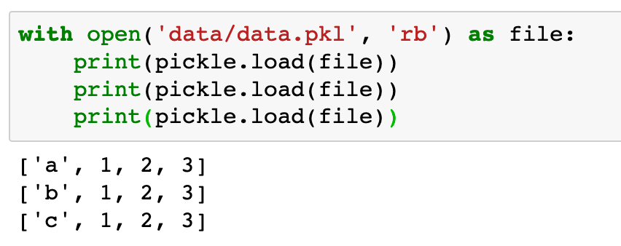
c
dump
load
Hard

Slide 25

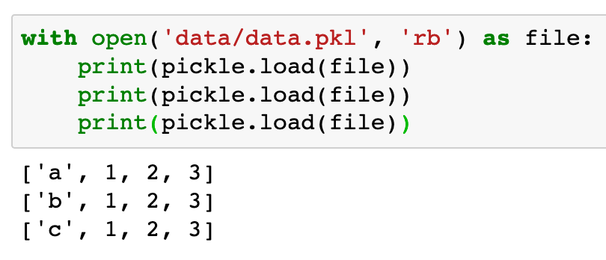
So Far
dump
load
Hard

Slide 26
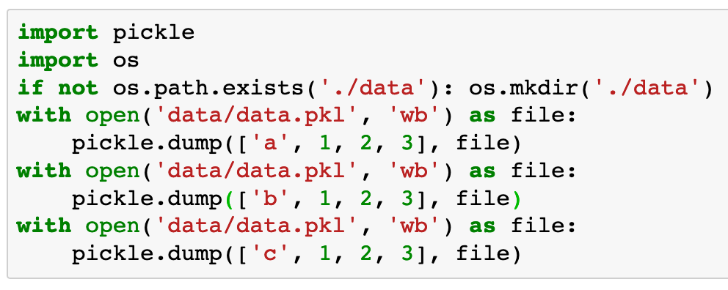
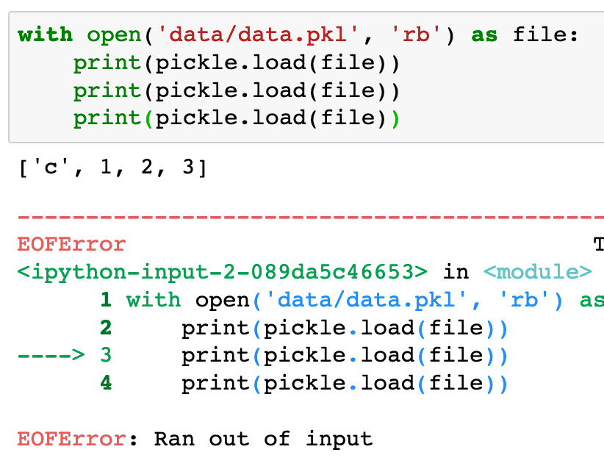
dump
load
Hard

Slide 27
dump
load
Hard
Not Good

Slide 28
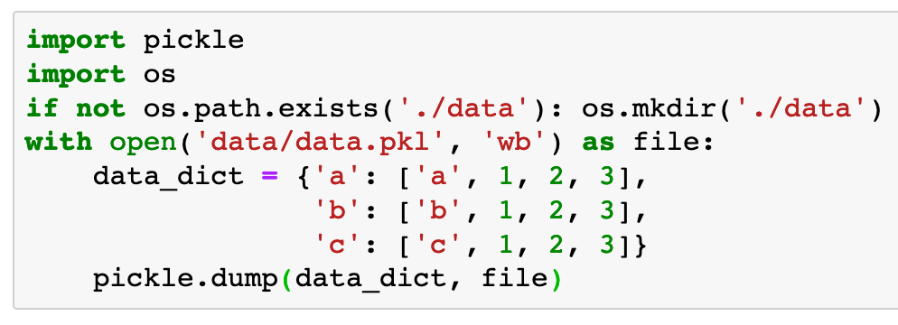
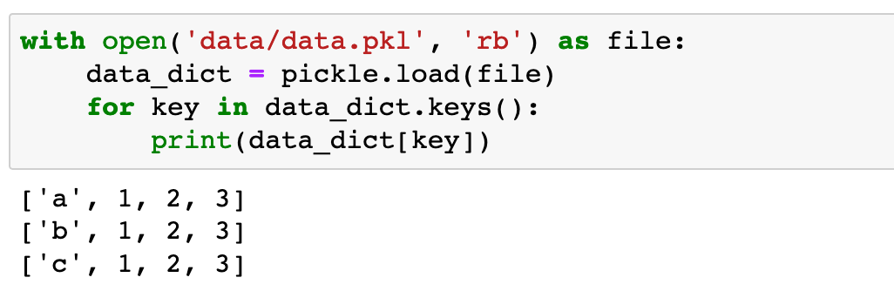
dump
load
Hard
Recommended Way Of Using Pickle

Slide 29
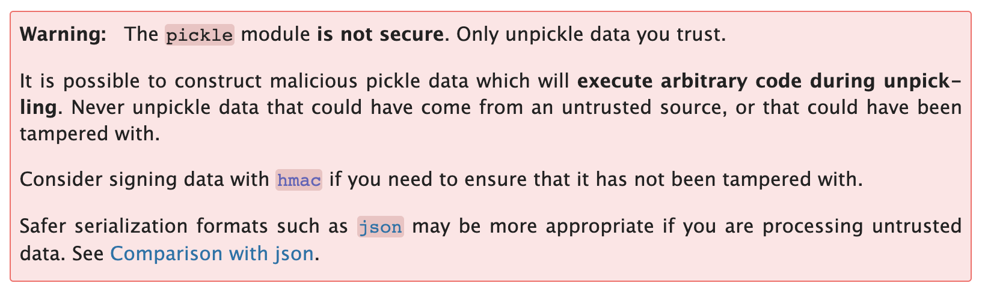
Serious Warning from Pickle

Slide 30
Now
Let’s Play with Code

